Slide 1
Point Estimation and Sample Statistics Point Estimation and Sample Statistics Point Estimation and Sample Statistics Point Estimation and Sample Statistics Point Estimation and Sample Statistics Hypothesis Testing

Slide 2
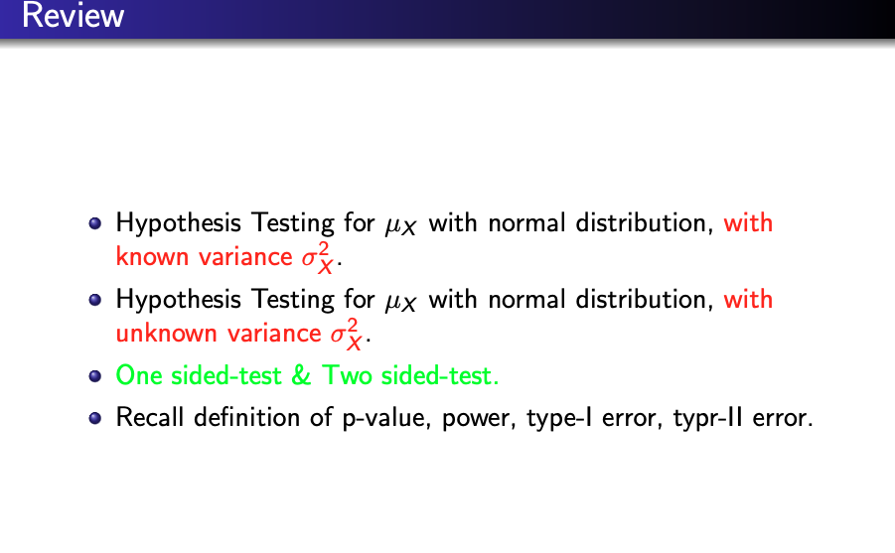

Slide 3
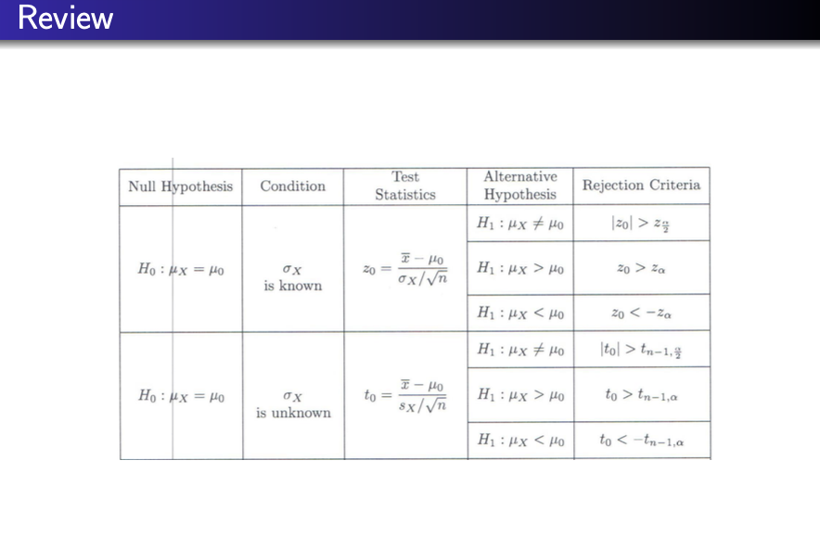

Slide 4
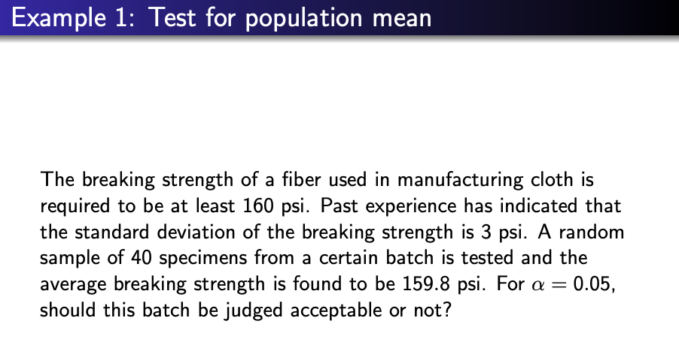

Slide 5
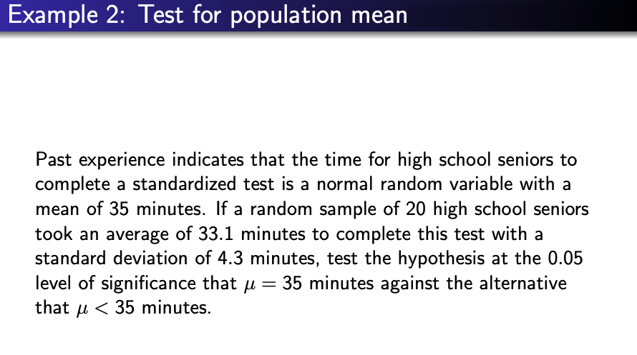

Slide 6
